Slide 1





GREEN COMPUTING

Slide 2


INTRODUCTION
Green computing is the environmentally responsible and eco-friendly use of computers and their resources.
In broader terms, it is also defined as the study of designing, manufacturing/engineering, using and disposing of computing devices in a way that reduces their environmental impact.
It is also called as Green IT

Slide 3

HISTORY
Green computing was Originated in 1992 at the U.S Environmental Protection Agency that launched Energy Star program.
Shortly after that the term “Green Computing” was coined.

Slide 4
WHY IS GREEN COMPUTING REQUIRED?
Impact of Electricity to the Environment
Uses lot of electricity
Impact of Toxic waste to the Environment

Slide 5
WAYS FOR GREEN COMPUTING
Turn off monitor
Turn off hard disks
System Standby / Sleep
Hibernate

Slide 6
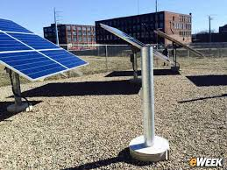
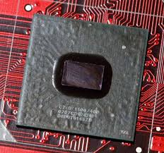
METHODS TO IMPLEMENT GREEN COMPUTING
Solar computing
Carbon free computing

Slide 7
METHODS CONTD…
1. SOLAR COMPUTING
Computers working with the help of solar technology are called solar computing
2. CARBONFREE COMPUTING
Carbon free computing is a set of programs and products designed to help individuals and organizations reduce their impact on the environment

Slide 8
REGULATIONS AND INDUSTRY INITIATIVES
The organization of economic co-operation and development (OECD) has published a survey of over 90 government and industry initiatives on green computing.
The report concludes that initiatives tend to concentrate on the green computing themselves rather than actual implementation to tackle global warming and environmental degradation.
In general, only 20% of initiatives have measurable targets, with government programs tending to include targets more frequently than business associations.

Slide 9
Many governmental agencies have continued to implement standards and regulations that encourage green computing.
The energy star program was revised in October 2006 to include stricter efficiency requirements for computer equipment, along with a tiered ranking system for approved products.

Slide 10
INDUSTRIES
CLIMATE SAVERS COMPUTING INITIATIVES (CSCI) is an effort to reduce the electric power consumption Of PCs In active and inactive states.
The GREEN ELECTRONICS COUNCIL offers THE ELECTRONIC PRODUCT ENVIRONMENTAL ASSESSMENT TOOL (EPEAT) to assist in the purchase of “greener” computing systems.
GREEN COMM CHALLENGE is an organization that promotes the development of energy conservation technology and practices in the field of information and communications technology.

Slide 11
BENEFITS
Improve the savings
Eco-friendly and environment friendly

Slide 12
SOME ADVICES
When you must print, do it double sided.
Edit on screen, not on paper
Save to disk instead on printing on paper

Slide 13
!! THANK YOU !!

